Slide 1


Slide 2


Emotional Intelligence - Personality Test

Slide 3
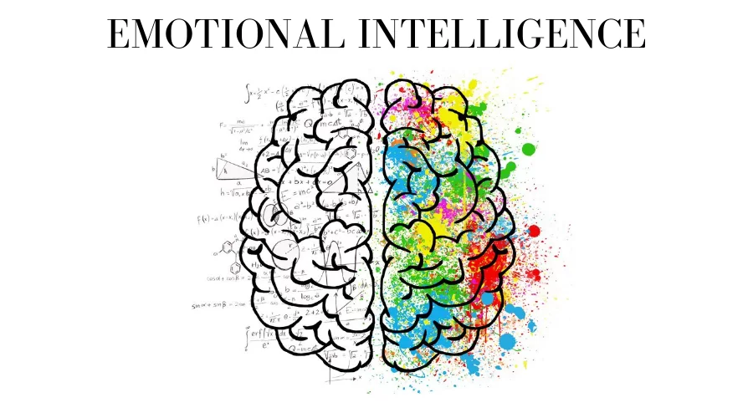
INTRODUCTION
What is Emotional Intelligence?

Slide 4
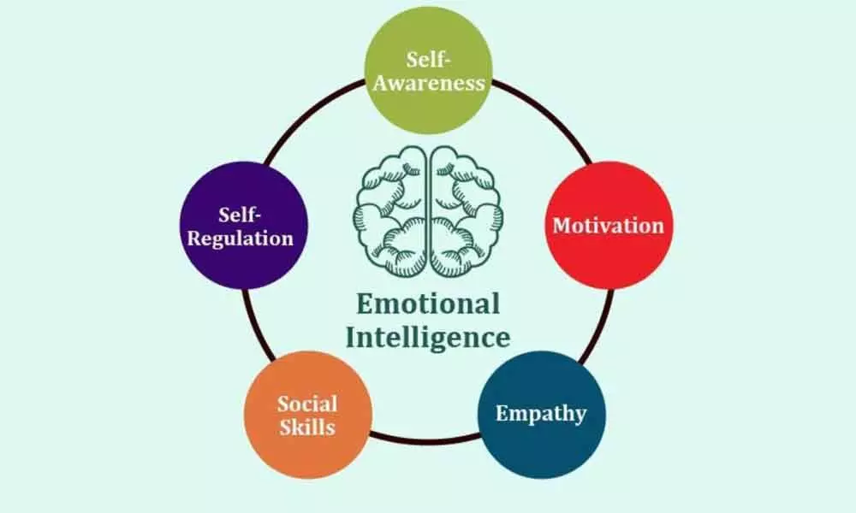
CONCEPTS
Characteristics of Emotional Intelligence

Slide 5
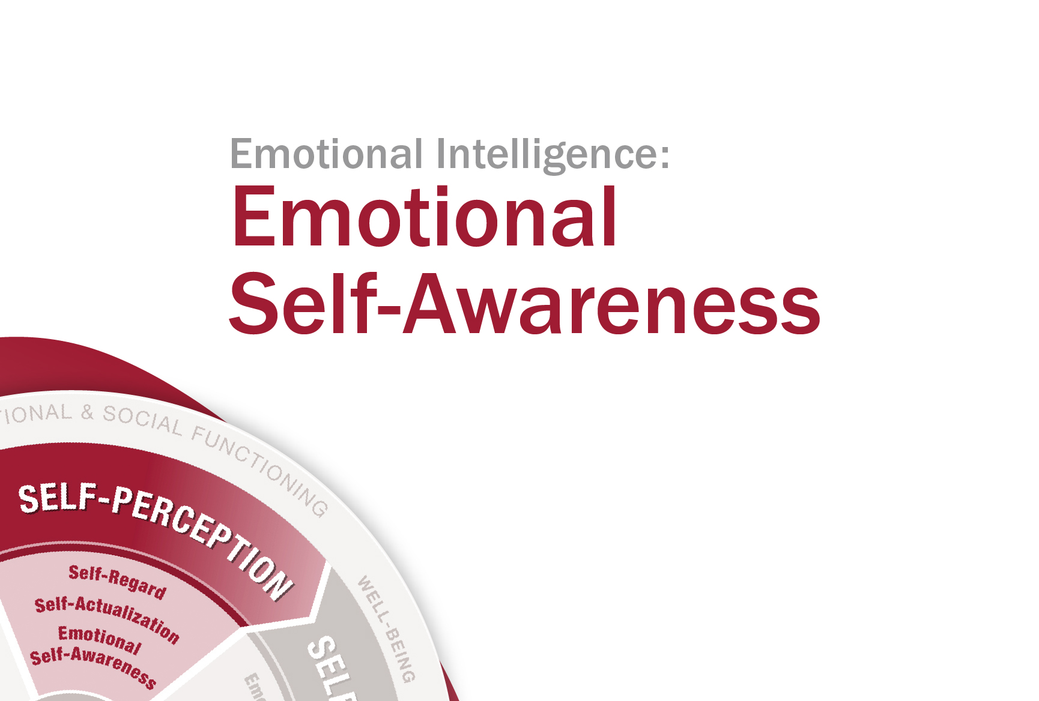
CONCEPTS
Self-Awareness
Notes:
https://www.betterup.com/blog/what-is-self-awareness
https://www.betterup.com/blog/what-is-self-awareness
"Self-awareness is the ability to focus on yourself and how your actions, thoughts, or emotions do or don't align with your internal standards. If you're highly self-aware, you can objectively evaluate yourself, manage your emotions, align your behavior with your values, and understand correctly how others perceive you."
Put simply, those who are highly self-aware can interpret their actions, feelings, and thoughts objectively.
It’s a rare skill, as many of us spiral into emotion-driven interpretations of our circumstances. Developing self-awareness is important because it allows leaders to assess their growth and effectiveness and change course when necessary.

Slide 6
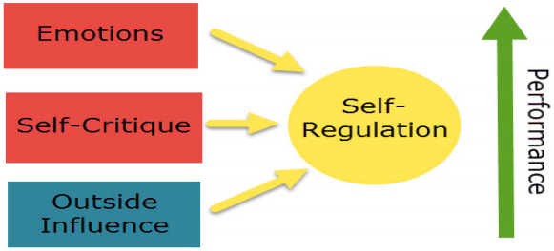
CONCEPTS
Self-Regulation
Notes:
https://www.yourtherapysource.com/blog1/2020/01/19/what-is-self-regulation-2/
Self-regulation is the ability to monitor and manage your energy states, emotions, thoughts, and behaviors in ways that are acceptable and produce positive results such as well-being, loving relationships, and learning.

Slide 7
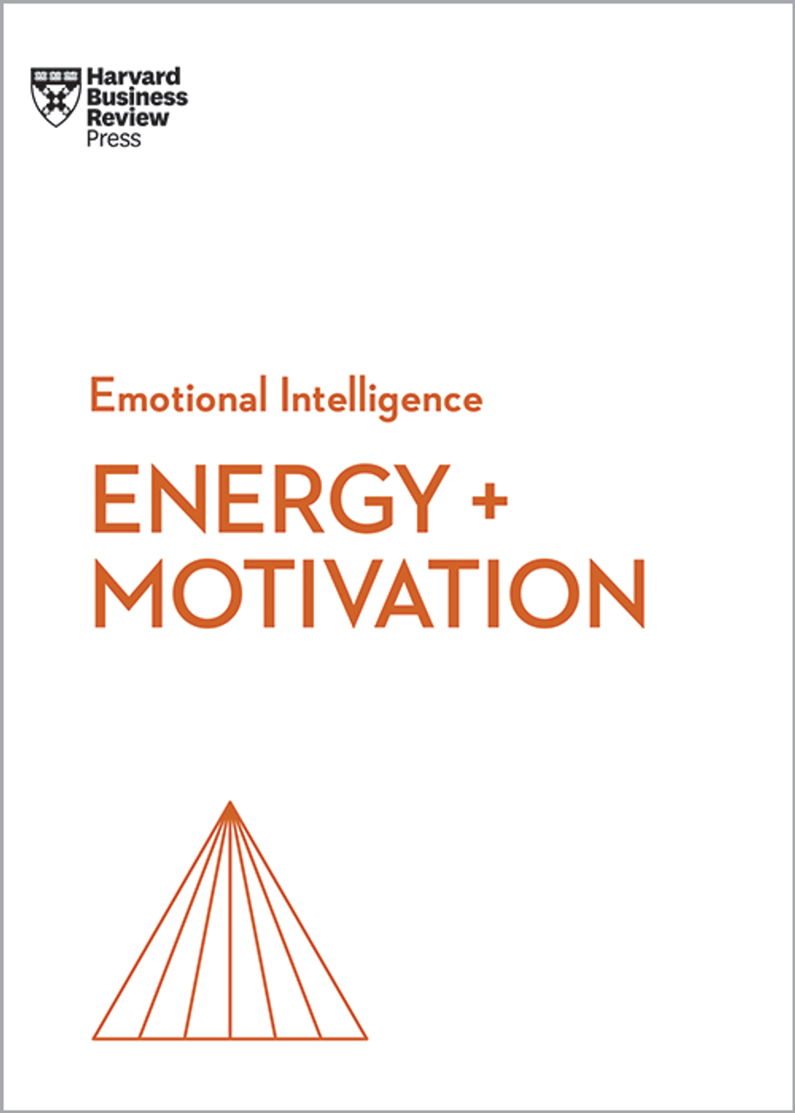
CONCEPTS
Motivation
Notes:
https://blogs.oracle.com/jobsatoracle/post/motivation-a-key-component-of-emotional-intelligence
Motivation is what pushes us to achieve our goals, feel more fulfilled and improve overall quality of life. Daniel Goleman, who developed the concept of emotional intelligence in the mid ‘90s, identified four elements that make up motivation: our personal drive to improve and achieve, commitment to our goals, initiative, or readiness to act on opportunities, as well as optimism, and resilience.
How do these four elements concretely add up to becoming more successful? Well, let’s go back to our statement on IQ and how it takes more than just being smart to make it in your career. While it helps to be knowledgeable, you’ll find that without the proper motivation, the quality of your work won’t reach its full potential. It’s all about loving what you do, and doing what you love. The mechanism is simple—when we enjoy our work, we’re known to be more productive and deliver better results. It’s the loving what we do that gets us motivated, and it’s the motivation that drives us to working harder and generating high quality work products. This is what experts call intrinsic motivation, the kind that comes from within and fuels you with desire to overcome a challenge, to produce high-quality work, or to interact with team members you like and trust.

Slide 8
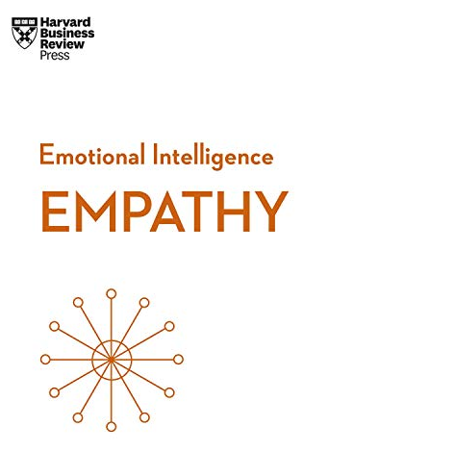
CONCEPTS
Empathy
Notes:
https://www.verywellmind.com/what-is-empathy-2795562
Empathy is the ability to emotionally understand what other people feel, see things from their point of view, and imagine yourself in their place. Essentially, it is putting yourself in someone else's position and feeling what they are feeling.
Empathy means that when you see another person suffering, such as after they've lost a loved one, you are able to instantly envision yourself going through that same experience and feel what they are going through.

Slide 9
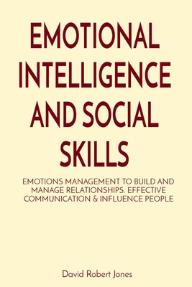
CONCEPTS
Social Skills
Notes:
https://study.com/learn/lesson/social-skills-types-purpose-examples.html
Social skills are healthy ways of relating to others that promote positive interactions. This include the words, gestures, and body language that are used during social interactions. The main purpose of social skills is to help an individual be able to interact with others in society. Social skills help build better relationships through more efficient communication. Having good social skills is advantageous to social interactions and social functioning because it helps a person to be a better communicator. Social skills involve understanding what is socially acceptable and appropriate at what times.

Slide 10
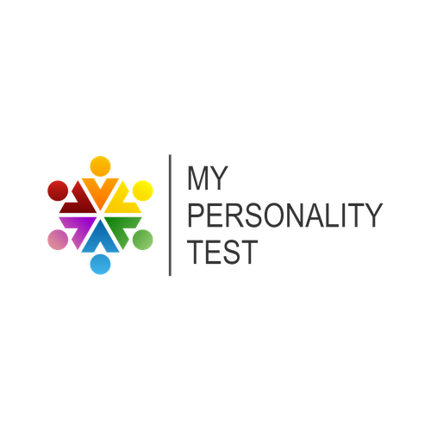
CONCEPTS
What is a personality test?
Notes:
https://www.verywellmind.com/what-is-personality-testing-2795420
A personality test is a tool used to assess human personality. Personality testing and assessment refer to techniques designed to measure the characteristic patterns of traits that people exhibit across various situations. Personality tests can be used to help clarify a clinical diagnosis, guide therapeutic interventions, and help predict how people may respond in different situations.
Personality is something that we informally assess and describe every day. When we talk about ourselves and others, we frequently refer to different characteristics of an individual's personality. Psychologists do much the same thing when they assess personality but on a more systematic and scientific level.

Slide 11
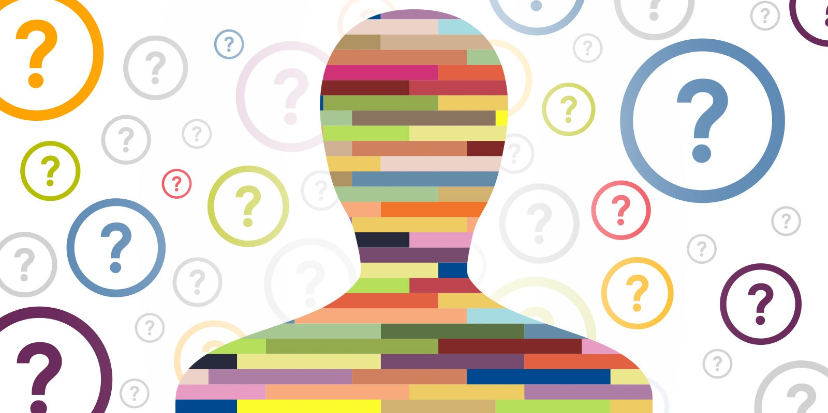
CONCEPTS
How Emotionally Intelligent Are You?

Slide 12
CONCEPTS
Questions | Not at all | Rarely | Sometimes | Often | Very often
I can recognize my emotions as I experience them.
I lose my temper when I feel frustrated.
People have told me that I'm a good listener
I know how to calm myself down when I feel anxious or upset.
I avoid conflict and negotiations.

Slide 13





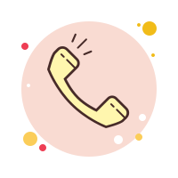

/ethnuscodemithra
Ethnus Codemithra
/ethnus
/code_mithra
THANK YOU
https://learn.codemithra.com/
codemithra@ethnus.com
+91 7815 095 095
+91 9019 921 340

